Slide 1
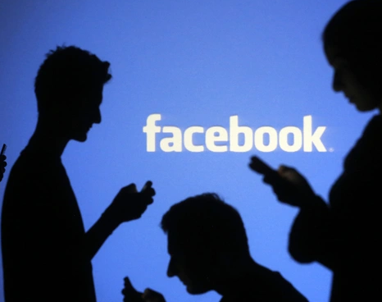
Facebook Data analysis
EDA project by Satheesh.V

Slide 2

Agenda
Introduction
About the data set
Inferences
Conclusion

Slide 3
Introduction
Facebook was launched on February 4, 2004, by Mark Zuckerberg and his Harvard College roommates
Available as a mobile app and website.
2.8 billion active users.
Constantly improving with innovations and updates.
New features: Money Requests, Facebook Marketplace, Facebook Instant Articles.

Slide 4
About the data set
URL to the data set: https://github.com/insaid2018/Term-1/raw/master/Data/Projects/facebook_data.csv
Details of Users with their gender, likes, friend counts, tenure, mobile/www likes were provided in the dataset.
Total of 99003 user details were provided.
< 1% of data had null values (in gender and tenure columns).
Age ranges from 15 to 121 years.
No duplicate records.
Tools used:
Pandas and Numpy – for analysis on the data
Seaborn library and Matplotlib – for visual representation

Slide 5
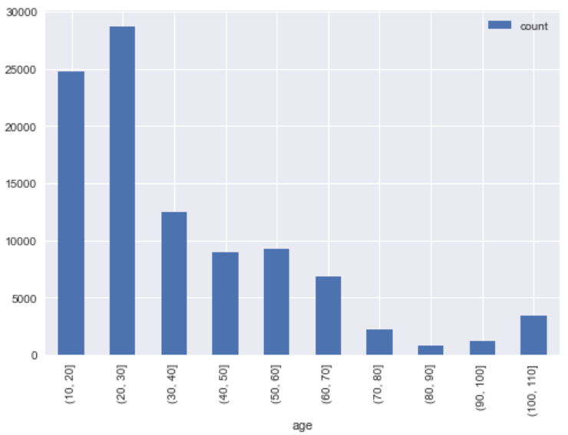
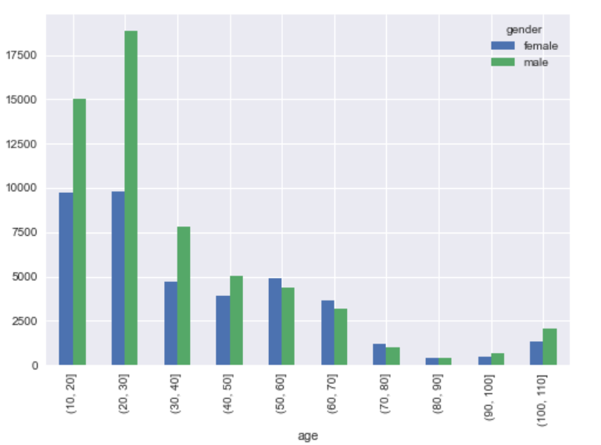
Inference - 1
The dataset has more users in the age group 10 – 30
Among them, Male users dominate in that age group.

Slide 6
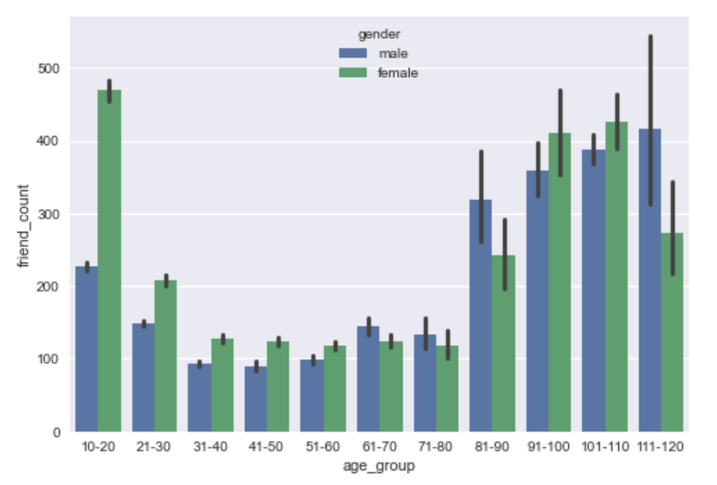
Inference - 2
Male users in the age group 10 – 50 have more friends. However beyond 50, the female users have more friends than the male counterparts.

Slide 7
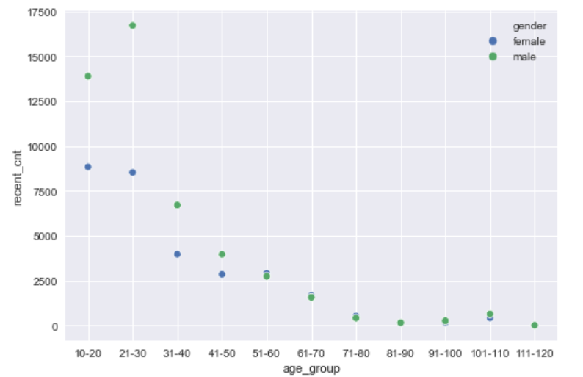
Inference - 3
In the last 2 years, more male users in the age group 10 – 30 have joined facebook.

Slide 8
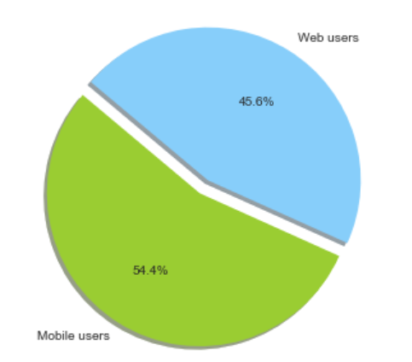
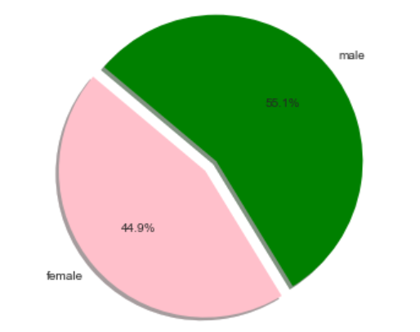
Inference - 4
People use mobile app more than web.
Male users use more mobile app than female users.

Slide 9
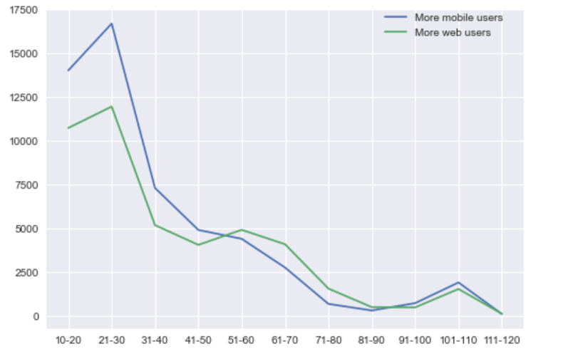
Inference - 5
Age group 10-50 use more mobile app than web.
However, age group > 50 are predominantly comfortable using web

Slide 10
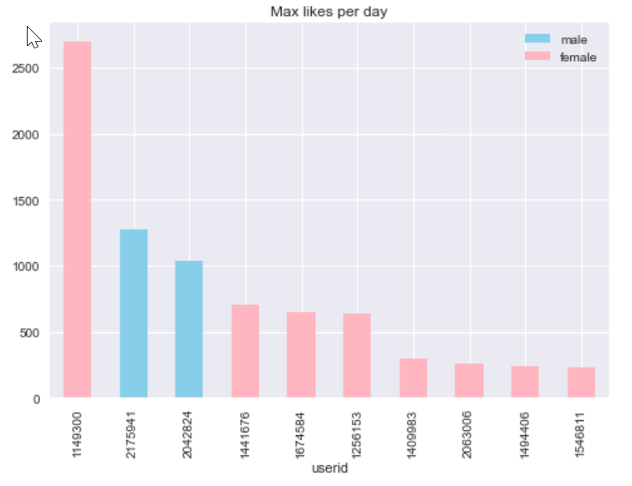
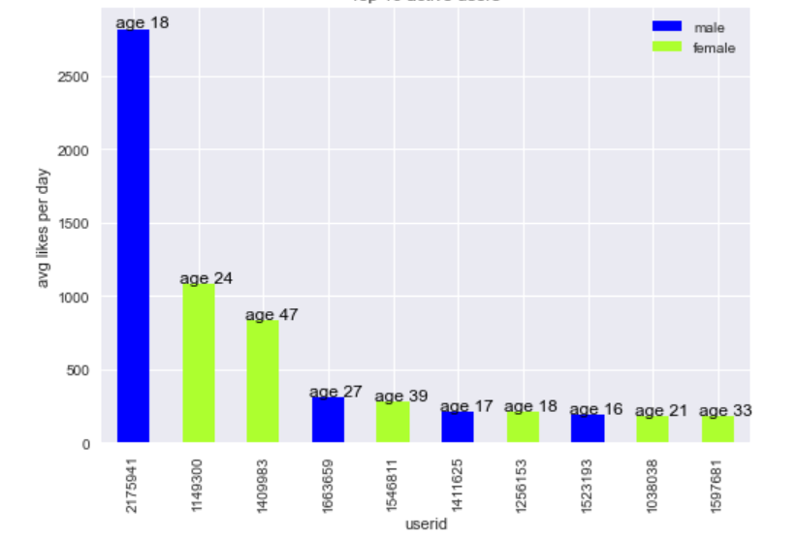
Inference - 6
User 1149300 has the highest number of likes per day.
User 217591 aged 18 is the most active user as he has clicked most likes in his tenure.

Slide 11
Conclusion
The younger generation is registering to Facebook.
There are not much users with age group > 50. The company should encourage users > 50yrs of age to use Facebook.
Users who are actively using facebook are in the younger age group (<30)
Mobile app has gained more popularity than web off-late.
Female users are more popular than male counterparts

